Slide 1
An initial understanding
Christopher I. Macintosh, PhD, RN
Notes:
Hello everyone
My name is Chris Macintosh. I help teach the capstone courses.
In this video we’re going to continue looking at the steps to develop our project proposal.
We’re going to look at some things we can do to gain an initial understanding of our project.
[Next slide]

Slide 2
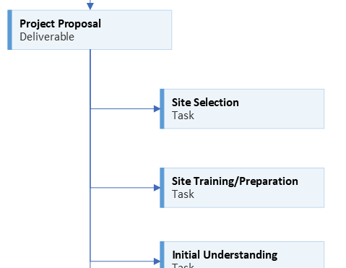
Notes:
We ended the last video by looking at some first steps.
[click]
Before anything else can happen, we need to make sure everyone gets matched up with a practicum site and a site preceptor.
[click]
If your site has any mandatory trainings for students, those need to be completed before much else can be done.
[Next slide]

Slide 3
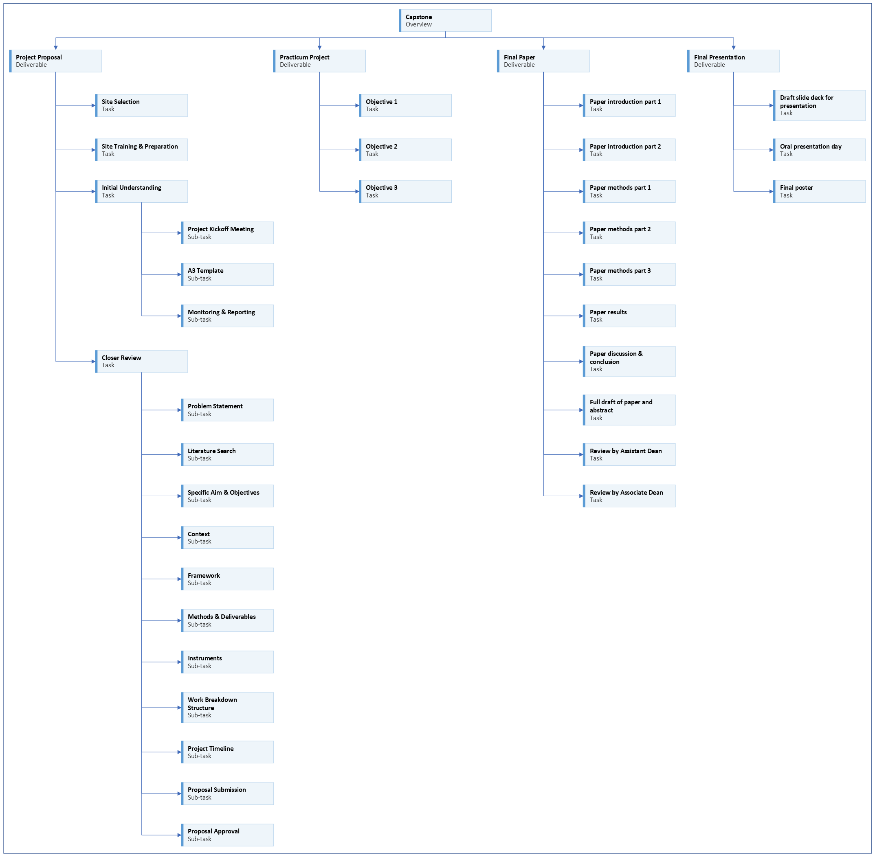
Notes:
In this video we’ll look at an important next step.
[Next slide]

Slide 4
Notes:
[click]
We need to get an initial understanding of our project.
[click]
You need to set up an initial meeting with your practicum preceptor.
This first meeting may be somewhat informal.
It may just be a chance for everyone to get to know each other.
But eventually, you’ll need to get down to the business of planning your project.
In project management, the formal start of a project is often called a project kickoff meeting.
[click]
It would be helpful in this initial planning phase, if you can have some kind of structure to help guide you through getting to know important parts of your project, how much has already been planned, and what parts still need to be ironed out.
You should have been introduced to the A3 template in your quality improvement course.
[Next slide]

Slide 5










the capstone toolkit
Notes:
Before we talk about the A3 template, I want to introduce the Capstone Toolkit.
The Capstone Toolkit is a collection of forms and tools that will help you as you plan and execute your project.
The tools have been collected in an Excel workbook.
There are a lot of sheets in the workbook.
We’ll introduce them one at a time as we need them.
You don’t need to understand what all of the sheets are for right now. Just focus on the particular sheets I talk about during the presentation.
[Next slide]

Slide 6
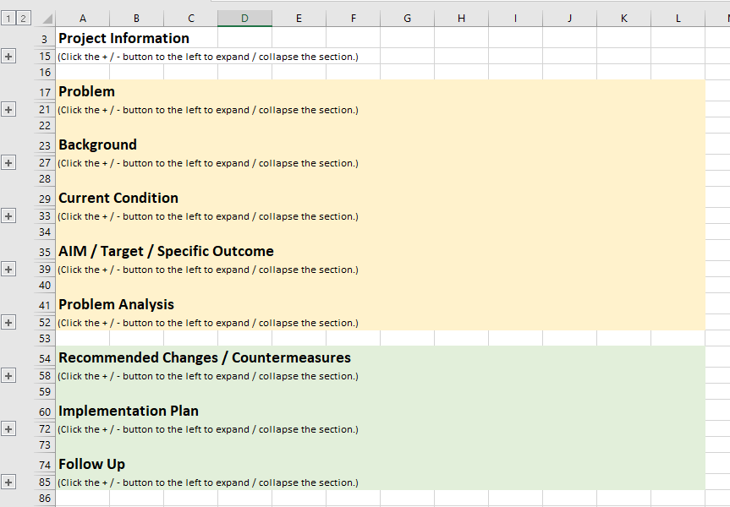
The A3 template
Notes:
The A3 template is a one-page summary of a quality improvement project.
It is a good tool to use here to get a quick overview of your project and get an idea of what kind of planning still needs to happen.
It is divided into two main halves.
The first half focuses on the problem you’re trying to solve.
And the second half focuses on the solution you’re trying to implement.
There are many different A3 templates available on the internet.
There are links to additional information about the A3 template in Canvas.
I have included a version formatted on an Excel worksheet in the Capstone Toolkit.
I have color coded the two main halves of the A3 template included in the Toolkit.
The yellow part is about the problem, and the green part is about the solution.
[click]
I have created collapsible sections in this version to make it easier to see the different parts at a glance.
Individual sections of the A3 template here can be expanded by clicking on the plus signs in the sheet’s left margin.
[click]
The sections of the A3 template can help guide you and your practicum preceptor in discussing the key elements of your project.
As you discuss the individual sections, they may also help you identify gaps in the project plan.
Once a gap in the plan has been identified, you and your project preceptor can work together to create what is still needed.
[Next slide]

Slide 7
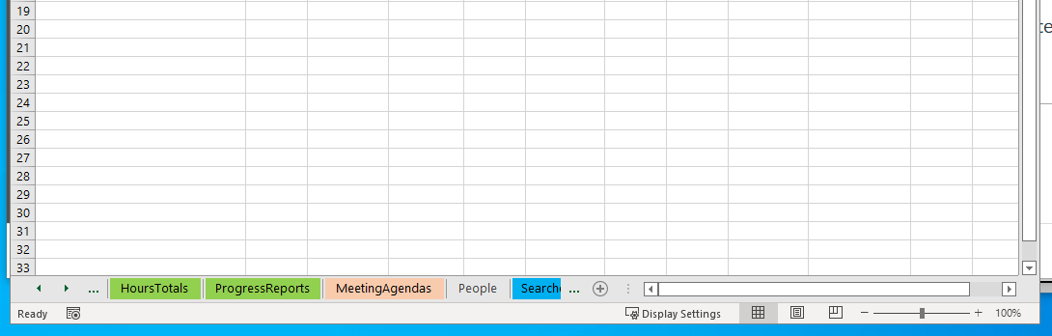
Notes:
[click]
The Capstone Toolkit is an Excel workbook that contains multiple sheets.
Tabs for sheets can be seen along the bottom of the window.
[click]
You can move the visible sheet tabs by clicking the left and right arrows in the bottom left corner of the window.
[click]
Look through the available sheet tabs until you find the desired sheet and click on the tab.
[next slide]

Slide 8
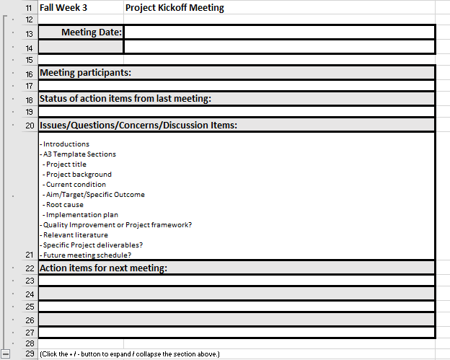
The project kick-off meeting
Notes:
Sample meeting agendas are included in the Capstone Toolkit, including one for the project kick-off meeting. (Shown here.)
Once you are assigned to a project site and preceptor, you should create a proposed agenda.
Set up a time to meet with your preceptor.
Send the proposed agenda to your project preceptor and see what agenda items they feel are important to discuss.
[Next slide]

Slide 9

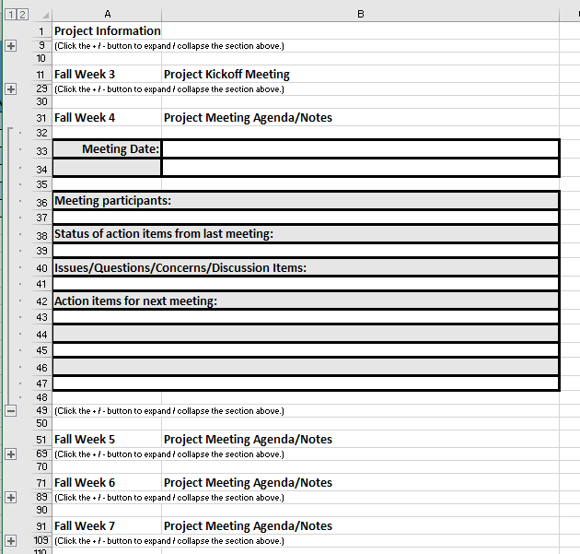
Meeting agendas
Notes:
It’s a good idea to hold regular progress meetings with your project preceptor.
This helps everyone stay on the same page in terms of what is happening with the project.
I recommend setting up a regular meeting time so you can coordinate as needed and make steady progress.
Meeting weekly for 30 minutes is probably a good cadence, but you and your project preceptor can decide what works best for your project.
If no one has anything to report to the group, the meeting can always be cancelled if it’s not needed.
I have included sample weekly meeting agendas in the Capstone Toolkit.
You don’t have to use the agendas in the toolkit, but I STRONGLY recommend you pick a consistent place to keep meeting agendas and notes.
Keeping meeting agendas and notes in a consistent place will help you know where to look in case you need to refer to your notes later.
I suggest keeping them on a cloud platform like Box so they’re available if you have to use a different computer or your regular laptop has problems.
[click]
I suggest using the MeetingAgendas sheet in the Capstone Toolkit or using Microsoft OneNote or a similar note taking software.
Keeping your notes in one of these applications makes them searchable.
Be sure to be well-prepared for regular meetings.
Have agenda items ready to go.
From an organizational standpoint, meetings are expensive.
When you hold meetings, there are a lot of people NOT doing their regular work.
Meetings are important for team coordination, but be sure time is not wasted during meetings.
Cancel meetings that are not needed ahead of time so people can make arrangements to work on other things.
[Next slide]

Slide 10
The project lifecycle
Initiation
Planning
Execution
Monitoring
Closing
Kick-off Meeting
Project Work
Manuscript & Presentation
Regular Meetings A3 template
Progress Reports
(Schwalbe, 2021)
Notes:
There are many ways to approach a project.
I find concepts from the field of project management helpful in knowing how to plan, organize, and execute the steps to complete a project.
A simple project may have these phases.
[click]
For capstone overall, we could define these phases like this.
Initiation – assigned project location and preceptor, kick-off meeting, review A3 template sections
Planning – regular meetings with preceptor, use A3 template for areas that need further planning,
Execution – doing the work needed on your project
Monitoring – regular progress reports
Closing – completing project objectives, writing your manuscript, delivering your presentation
These are shown here as a linear progression. In reality, there is a lot of iteration and bouncing back and forth between steps.
We can think of individual parts of Capstone as also each having these basic phases.
(creating the project proposal, completing the project, writing your manuscript, and delivering your presentation)
[Next slide]

Slide 11
Notes:
[click]
Monitoring and reporting are an important part of keeping any project on track.
[Next slide]

Slide 12
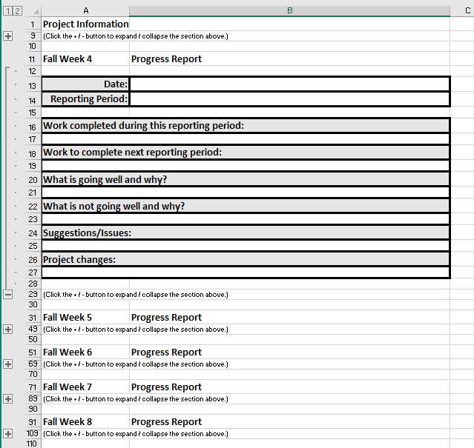
Progress reports
Notes:
You will submit regular progress reports in Canvas this semester and next semester.
A worksheet with a progress report form for each week is included in the Capstone Toolkit.
These reports are as much for you as for your instructor.
Filling out these reports each week will allow you to note the activities you performed on your project.
They’ll also allow you to note when project changes were made.
This will be helpful when you’re writing your project manuscript.
[Next slide]

Slide 13
Clinical practicum Requirements
Each Masters specialty track requires completion of clinical practicum courses, focusing on indirect clinical patient care. Clinical practicum experiences needed for specific roles in specialty areas are delineated by national specialty track nursing organizations. A minimum of 120 hours of clinical experience is included in the Master’s program of study. The Nursing Education specialty has additional practicum hours, focusing on applying education principles. Your Specialty Track Director and faculty will direct your engagement in clinical hours.
(University of Utah College of Nursing, 2022, p. 13)
Notes:
Note the Policy and Progression Manual specifies you should have at least 120 hours tracked for your capstone project.
It is anticipated about 30 of those hours will be tracked in the fall, and about 90 hours will be tracked in the spring.
But these totals for each semester are just a loose guideline.
You need to have enough hours logged to complete your capstone project.
[Next slide]

Slide 14
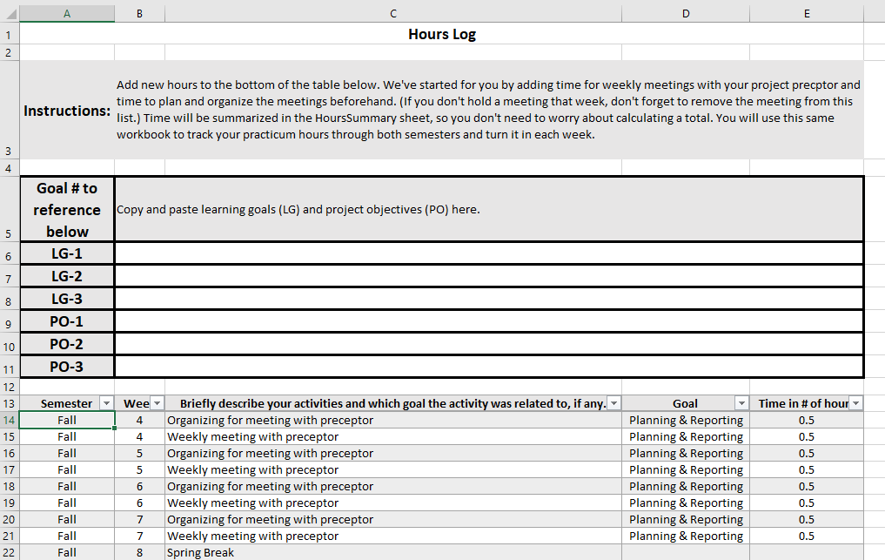
Tracking time
Notes:
An hours log is included in your Capstone Toolkit.
Track time spent on your project each week.
We’ve provided example entries for preceptor meetings.
Change the entries to reflect the time you actually spend planning for meetings and the meetings themselves.
Be sure to remove any entries for meetings that get cancelled.
[Next slide]

Slide 15

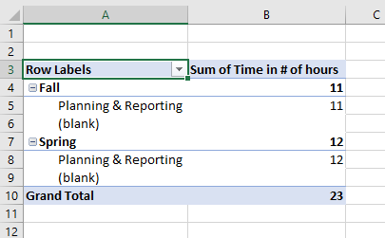
Total hours
Notes:
Your total hours can be seen in the HoursTotal sheet next to your hours log.
This will allow you and your faculty to quickly see the time you’ve logged on your project when you turn in your Capstone Toolkit.
[Next slide]

Slide 16
Notes:
The project kick-off meeting and the A3 template are a good place to start, but they don’t provide enough detail to fully plan your project.
Because it is short, the A3 template also doesn’t have all the information needed for you to write your capstone manuscript.
[Next slide]

Slide 17
Notes:
While you continue to meet with your practicum preceptor to plan your project, you will also start to review the sections of the project proposal.
Upcoming assignments will go more in-depth on each section of your project proposal.
If you compare the sections of the A3 template with the sections of the project proposal, you will see they match closely.
Information you recorded on the A3 template will be used and expanded upon in the project proposal.
As you look at each section of the project proposal, you may find gaps in the plan you outlined on the A3 template.
Update your A3 template as you go along.
Discuss any needed updates and modifications to the project plan with your practicum preceptor.
[Next slide]

Slide 18

More to come . . .
Notes:
That’s all we’ll do in this video.
There is more to come.
[next slide]

Slide 19
References
Schwalbe, K. (2021). Healthcare project management, third edition: Predictive, agile, and hybrid approaches. Schwalbe Publishing.
University of Utah College of Nursing. (2022). Master's of science nursing program policy and progression manual 2022-2023. University of Utah College of Nursing. https://nursing.utah.edu/documents/masters-policy-and-progression20222023final
Notes:
These are the references.

